Slide 1
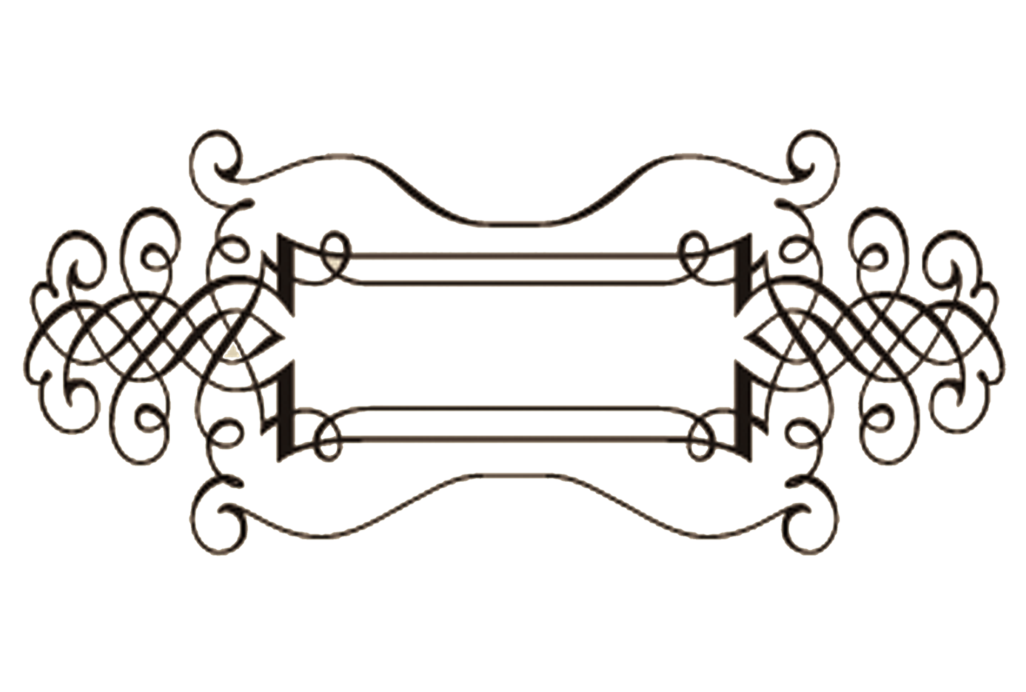
Pride and Prejudice

Slide 2

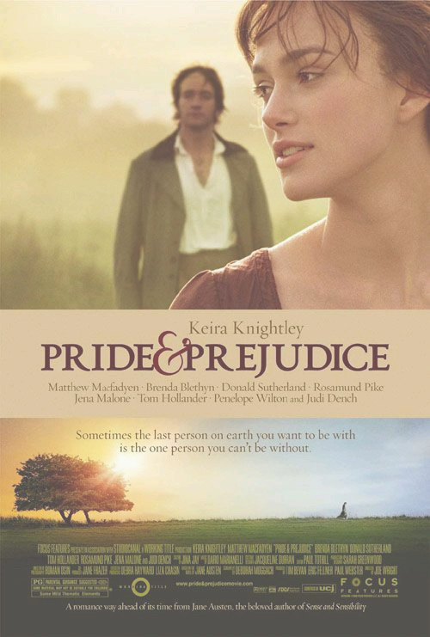
Directed by: Joe Wright
Written by: Jane Austen (novel),
Deborah Moggach, Emma Thompson (Script)
Genre: Drama | Romance
Cast:
*Keira Knightley － Elizabeth Bennet
*Matthew MacFadyen － Mr. Darcy
*Rupert Friend － Mr. Wickham
*Brenda Blethyn － Mrs. Bennet
Nominations:
Won four Academy Awards Nominations

Slide 3




Exercises
1. Decide whether the following statements are true (T), false (F) or not given (NG).
The first sentence is probably presented from a feminine viewpoint.
It’s very likely that Mrs. Bennet considered Mr. Bingley as the rightful property of one of her daughters.

Slide 4



Mr. Bennet cared much about Mr. Bingley’s fortune though he didn’t want to visit him.
To Mrs. Bennet, Lizzy was something more intelligent than her sisters.
Though Mr. and Mrs. Bennet had been married for more than 20 years, she still failed to understand his character.

Slide 5

2. Choose the best answer to each of the following questions.
1) What is Jane Austen’s main concern in her novel?
  Personal relationships, particularly with that between men and women in love.
  Personal relationships, particularly with that between parents and children.
  Personal relationships, particularly with that between siblings (兄弟，姐妹).
  Personal relationships, particularly with that between friends.

Slide 6

2) What does Jane Austen write about?
  Significant events happened in English history in 18th century.
  Significant events happened in English history in 19th century.
  The urban trading class with the trivial incidents of their business life.
  The landed gentry (绅士阶层) families with the trivial incidents of their everyday life.

Slide 7

3) Which of the following best describes the characteristic of Jane Austen’s language?
  Typically neoclassical language, simple, easy, naturally clear and very economical.
  Typically wordy rhetoric (华丽的文词), complicated, hard and difficult to understand.
  Typically rich in metaphor and simile.
  Typically everyday English expression.

Slide 8

4) Which of the following best describes the style of chapter one of Pride and Prejudice?
Extravagant description of the setting.
Extravagant description of the appearance of the characters.
Extravagant description of the inner world of the characters.
Extravagant use of dialogues.

Slide 9

5) Which of the following best describes the tone of Pride and Prejudice?
Serious and bitter.
Harsh and satirical.
Light, satirical, and vivid.
Bitter, sour and dull.

Slide 10
6) What is the narrative point of view of Pride and Prejudice?
First-person view.
Second-person view.
Third-person view.
Alternating person view

Slide 11
7) How does Jane Austen present and establish the images of Mr. and Mrs. Bennet?
By exposition.
By direct commentary.
By description.
By exposition and direct commentary.

Slide 12

8) What kind of ironic suggestion does Jane Austen make in the opening sentence of Pride and Prejudice?
The families in the society she wrote about were always looking for rich men to whom they could marry their daughters.
It’s really difficult for a rich man in the society to find his Miss Right.
A rich man must need a wife.
True love was hard to find.

Slide 13

9) Who was Mr. Bennet’s favorite daughter?
A. Jane B. Lizzy C. Lydia D. Kitty

Slide 14
10) How did Mrs. Bennet react to Mr. Bennet’s remark “you are as handsome as any of them, Mr. Bingley might like you the best of the party”?
She understood that he said in an ironic way, so she immediately argued back.
She understood that he said in an ironic way, but she did not argue back.
She failed to see the irony way and took it as a kind of flattery instead.
She felt so strongly all at once that she couldn’t help attacking him.

Slide 15





3. Change the form of the given words to complete the summary of chapter one.
The Bennets are considering the prospects of their daughters’ 1)_________(marry) shortly after hearing of the 2)_________(arrive) of a rich single young man, Mr. Bingley, as their neighbor. The 3)_________(converse) between Mr. and Mrs. Bennet subtly present their incompatible (不相容的) relationship and their attitude towards each other. It also shows that Mrs. Bennet is an empty-minded woman and Mr. Bennet is a man of quick wit whose 4)_________(tease) tone and sarcastic humor are just beyond his wife’s 5)_________(understand).

Slide 16
4. Classify the characteristics of Mrs. and Mr. Bennet, and then discuss with your partner about whom you like better and why.
Mrs. Bennet
Mr. Bennet

Slide 17



is eager to marry one of their daughters to Mr. Bingley, a single man with a large fortune.
does not care much about Bingley.
is a person whose only goal in life is to marry their daughters to rich young men.

Slide 18





is a person with quick wit and very good judgment.
is a mixture of quick parts, sarcastic humour, reserve, and caprice.
is a person of mean understanding, little information, and uncertain temper.
is skeptical of conventional marriage and has no good words for worldly people.
is good-looking but empty-headed, snobbish, garrulous (饶舌的) and vulgar(粗俗的).

Slide 19



